Slide 1
Apriori Algorithm
IT494 : Big Data Processing
Guide :
Professor PM Jat
TA - Vinay Sheth
Aditya Shah - 202003045

Slide 2
The objective of the paper :
The paper shows primarily how the Apriori algorithm works.
It also defines how this algorithm works in parallel processing.
To conclude the paper , the Apriori algorithm is executed in map-reduce and Apache spark, to compare the speed , and how each software copes with large data.
The last part comments more on both of these distributed processing of the algorithm.

Slide 3
Terminologies in Apriori Algorithm :
Frequent item set: Item set that appears frequently in a given transactional dataset.An itemset is said to be frequent if its support is greater than a given threshold.
Support_count(absolute support) : Number of times a particular item comes in transactions
Support(relative support) : It is a fraction of transactions in which an itemset occurs.
Minimum Support : A threshold value which tells whether an itemset is frequent or not.
Association Rule : If item A is in relation with item B (denoted by A B )
Confidence : determines how frequently , itemset B appear in transaction that contain itemset A.

Slide 4
Understanding Apriori Algorithm:
If we want to know what is apriori and why we should use it, first we have to learn about what is frequent itemset mining.
Frequent itemset mining:
It is a discovery of associations and correlations among items in large transactional or relational data sets.
In simple words, we are trying to find which items are appearing together in transactions.
Market basket analysis is one example of this.
Transaction data is a dataset which contains list of items bought by customers in a market and candidate data stores all the items which are in the market basket data

Slide 5
Why need to use Apriori?
For getting frequent itemsets, first, we have to create all possible lengths of candidate itemsets and then we need to compare all these candidate itemsets with the transaction set.
We can say that the itemset is frequent if its support value is above the support threshold value.
To avoid these needless computations, we can prune all itemsets which were infrequent earlier.
And to do that we use the apriori algorithm.
In short, to decrease the number of comparisons and for decreasing the number of candidate itemsets, we are using the apriori algorithm.

Slide 6
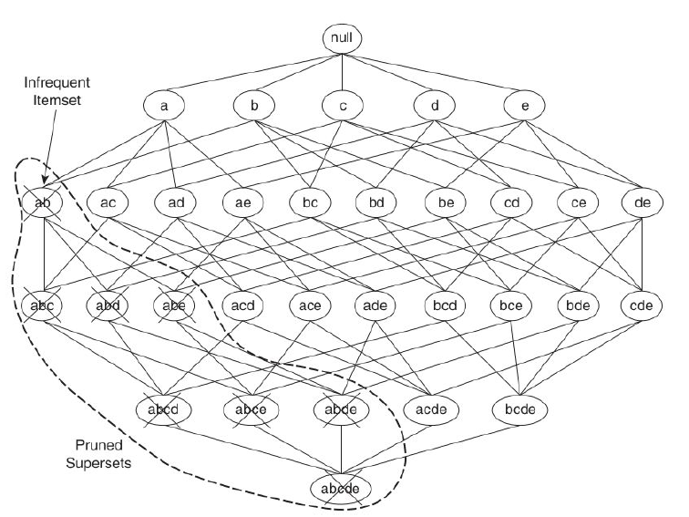
Why need to use Apriori : Image

Slide 7
Method of Apriori Algorithm:
There are mainly two principles that we need to know for using apriori algorithm.
Apriori Principle: If an itemset is frequent, then all of its subsets must also be frequent.
Apriori Pruning Principle: If an itemset is infrequent, then all of its supersets must also be infrequent.
So by using Pruning principle, we are eliminating the items/itemsets which are infrequent earlier so we don’t need to take in account the supersets of these infrequent items.
By doing this we are decreasing the number of itemsets to create and compare them. Also we are reducing the computational complexity.

Slide 8
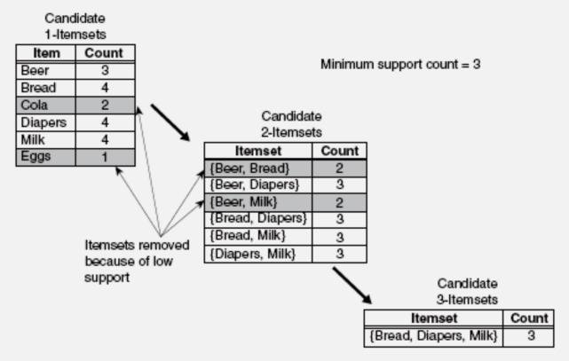
Example Of Apriori Method:

Slide 9
SEQUENTIAL ALGORITHM:
-FIL_1 = Frequent itemset of 1 length
k = 2
-while ( FIL_k != 0 ):
{
C_k = {a + b | a belongs to FIL_1(k-1)
& b belongs to FIL_1(k-1) & their
k-2 items should be identical }
for each c in C_k:
for each t in TID:
If ( c belongs to t ):
Count[c] += 1
If ( Count[c] >= min_sup ):
FIL_k += c
k += 1
}

Slide 10
MAP-REDUCE ALGORITHM:
PHASE 1: For 1 length Frequent Itemset
MAPPER (key (C_No) , value (row)) :
-Read TID
-for each t in TID:
Output( t , 1 )
REDUCER (key (c) , value (list of 1's)) :
-sup = 0
for each v in value (list of 1’s ):
sup +=1
if(sup >= min_sup)
Output( c(itemset) , sup )

Slide 11
PHASE 2: For k length Frequent Itemset
MAPPER (key (C_No) , value (row)) :
-Read TID ( using mapper_init )
-Read L_k-1 Frequent Itemset List ( using mapper_init )
-C_k = {a + b | a belongs to FIL_1(k-1)
& b belongs to FIL_1(k-1) &
k-2 items should be identical }
-for each c in C_k:
for each t in TID:
if( c belongs to t)
Output( c(itemset) , 1 )
REDUCER (key (c) , value (list of 1's)) :
-sup = 0
for each v in value( list of 1’s ):
sup +=1
if(sup >= min_sup)
Output( c(itemset) , sup )

Slide 12
Limitations of MRJOB
Apriori algorithm needs iterative structure, but it does not stores the previous output.
For each iteration ,MRJOB will have to write back to HDFS, which will create a lot of overhead I/O

Slide 13
YAFIM (Introduction)
YAFIM’s full form is Yet Another Frequent Itemset Mining.
YAFIM is based on spark-RDD
It has parallel processing
It was created by Yefim Abramovich

Slide 14
YAFIM ALGORITHM:
PHASE 1: For 1 length Frequent Itemset
-for each t in TID:
for each i in t:
map( i , 1 )
-ReduceByKey( i , count )
-for each i :
Sum += count
-If ( Sum >= min_sup ):
Output( i , sum )

Slide 15
PHASE 2: For k length Frequent Itemset
- C_k = {a + b | a belongs to FIL_1(k-1)
& b belongs to FIL_1(k-1) &
k-2 items should be identical }
- for each c in C_k:
for each t in TID:
If ( c belongs to t )
map( c , 1 )
-ReduceByKey( c , count )
-for each c (key) :
while( count (value) != 0 )
Sum += count
-If ( Sum >= min_sup ):
Output( i , sum )

Slide 16
Dataset
We will be working on the dataset MushRoom.
This dataset is in the form that cannot not directly be run on the apriori algorithm , so first we will have to convert this dataset in the form that can be inputted in the apriori algorithm.
We will convert each attribute to an item , this will make 119 items and 8124 transactions.
This is confirmed in the YAFIM: A Parallel Frequency Itemset Mining Algorithm with Spark paper.
Also we will be using other datasets (Chess,T10I4D100K,Pumsb_star) , but we will execute and confirm our code on this dataset

Slide 17
System Configuration
The experiment conducted in the paper used thiese system configuration:
12 nodes in a cluster
Each node has two intel Quad Core Xeon CPU’s at 2.4GHz
24GB memory and 2TB disk
Linux Server 6.0
Spark - 0.7.3 was used for YAFIM and hadoop - 1.0.4 was used for MRApriori

Slide 18
Results
The Results show that YAFIM is much faster than MRApriori with YAFIM taking 0.9s seconds and MRApriori taking 34 seconds. This clearly shows YAFIM is 37 times faster on MushRoom dataset.
On an average of the four datasets YAFIM is 18 times faster than MRApriori.
When performance is analysed on scalability , we fix the number of cores to 48. When the size of data is increases two fold, three fold , etc . The execution time on MRApriori increases drastically whereas the execution time for YAFIM increases slowly.Which means the larger the data , the faster YAFIM is in relative terms

Slide 19
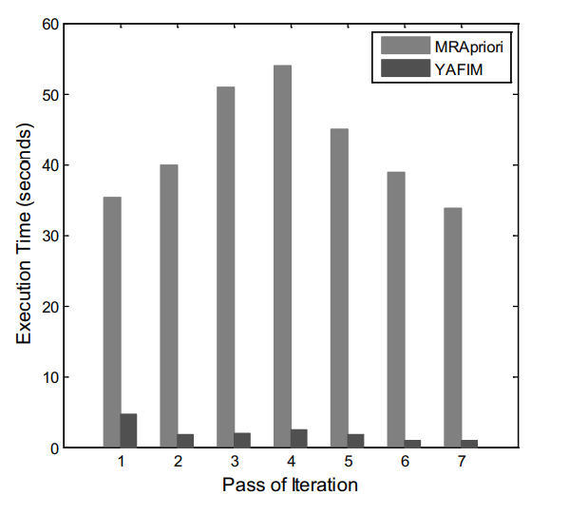
COMPARISON:
SPEED COMPARISON ( on MushRoom Dataset )

Slide 20
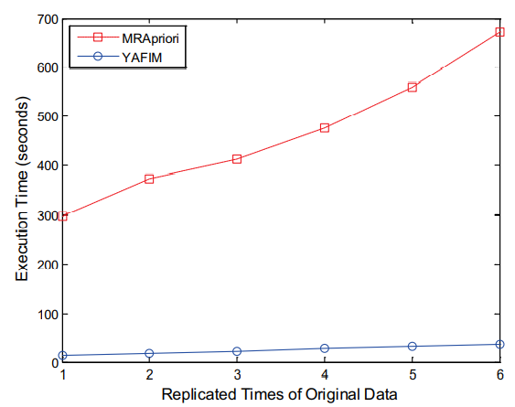
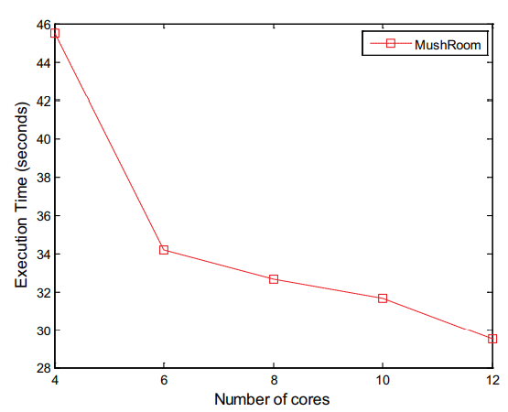
(b) SCALABILITY COMPARISON (on MushRoom Dataset)
For Both MRApriori & YAFIM
For YAFIM Only

Slide 21
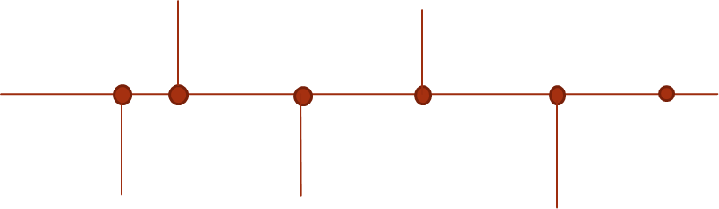
Timeline
Total number of days : 15 days (assuming presentation on 1st dec)
• Write code on map reduce – 4 days
•Write code on YAFIM – 4 days
•Compare results and generate graphs - 2 days
•Create report on our findings –3 days
•Double check – 1 day
•Buffer – 1 days
Compare the results , generate graphs
Write Code on map reduce
2nd Presentation
Write Code on YAFIM
1st Presentation
Create a report on our findings

Slide 22
References
Lin M., Lee P. & Hsueh S. (2012). Apriori-based Frequent Itemset Mining Algorithms on MapReduce. Proc. of the 16th International Conference on Ubiquitous Information Management and Communication (ICUIMC ‘12). New York, NY, USA, ACM: Article No. 76. (Algorithm)
https://images.app.goo.gl/QeFLwqxX3LCNLBCA7

Slide 23
Thank you

